Slide 1

Blood In The Hall
A murder mystery of a young student playable in google slides!
Play

Slide 2


At the police Station
Hmmm….What shall be the reason for a young boy like him to commit suicide?
NEXT →

Slide 3
At the police Station
Let’s take a look at the case files first.
NEXT →

Slide 4


VICTIM- Alex Carter
AGE- 17
TIME FOUND- 10:42
CAUSE- T.B.D
3 People questioned
View Statements -->

Slide 5
VICTIM- Alex Carter
AGE- 17
TIME FOUND- 10:42
CAUSE- T.B.D
3 People questioned
Best friend - Ryan
Neighbour - Mrs. Carter
Teacher - Mr. Blake
View statement
View statement
View statement

Slide 6

VICTIM- Alex Carter
AGE- 17
TIME FOUND- 10:42
CAUSE- T.B.D
3 People questioned
Best friend - Ryan
“I left his house around 8PM. He seemed completely normal. I didn’t see him after that.”
Investigate
Back

Slide 7

VICTIM- Alex Carter
AGE- 17
TIME FOUND- 10:42
CAUSE- T.B.D
3 People questioned
Neighbour - Mrs. Carter
“I heard 2 people arguing at around 9. I couldn’t understand what they were saying. After that everything went quiet.”
Investigate
Back

Slide 8

VICTIM- Alex Carter
AGE- 17
TIME FOUND- 10:42
CAUSE- T.B.D
3 People questioned
Teacher - Mr. Blake
“I hadn’t spoken to him that day. He didn’t come to school, and i had no reason to contact him.”
Investigate
Back

Slide 9
Let’s look at the CCTV Footage of Ryan.
NEXT →

Slide 10


🔴 CCTV
LOCATION:
WEST STREET SHOP
TIME: 9:05
SUBJECT: RYAN
NEXT →

Slide 11
Hmm… why did he lie? He left at 9:05 and said that he left at 8:30. Let me write it down.
Back→

Slide 12


I heard an argument so I went near the window and so Ryan leaving.
Next→

Slide 13
Hmm… why didn’t she first admit that she saw Ryan leaving? Let me write it down too.
Back→

Slide 14

🔴 CCTV
LOCATION:
WEST STREET SHOP
TIME: 09:18
SUBJECT: MR. BLAKE
NEXT →

Slide 15
Hmm… that was Mr. Blake’s car leaving at 9:18, why did he lie that he didn’t talk to him? Let me write it down.
Next→

Slide 16
Every statements and contradictions have been compiled. Let’s see what I wrote!
Next→

Slide 17
NOTES
RYAN -
Mrs. Carter -
Mr. Blake -
View notes
View notes
View notes

Slide 18
NOTES
RYAN -
Statement - he says that he left at 8
Contradiction - He actually left at 9:05.
Proof - CCTV
Back

Slide 19
NOTES
Mrs. Carter -
Statement - she says that she heard 2 people arguing at around 9. After that everything became quiet.
Contradiction - She didn’t initially mention that she saw Ryan leaving.
Proof - Interrogation
Back

Slide 20
NOTES
Mr. Blake -
Statement - He says that he didn’t meet the victim that day as it was a holiday in the school which meant that he didn’t have a reason to meet him.
Contradiction - His car was spotted near the victim’s house near the time of the incident.
Back
Next

Slide 21
At the police Station
Hmm… seems like we can make some decision. Let’s analyse it…
NEXT →

Slide 22

Then suddenly…
Sir, we found something crazy on the victim’s phone! It’s a strong evidence.
Show me Immediately.
NEXT →

Slide 23
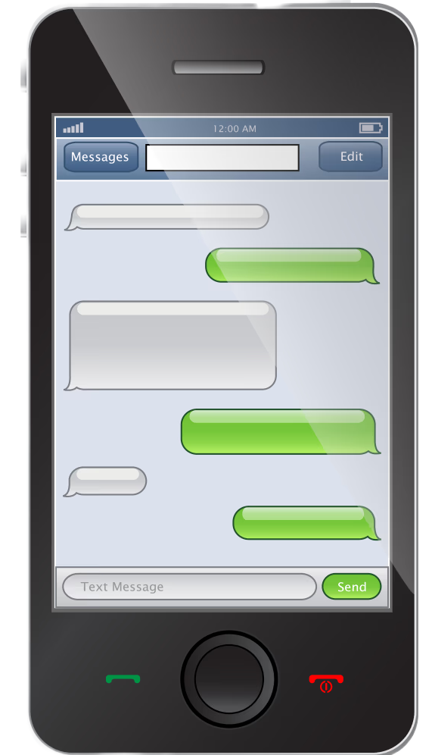
Mr. Blake
Hi. How are you?
Hi. I’m fine
We need to talk about what you found
I ain’t keeping it a secret
NO
Yes
NEXT →

Slide 24
YES! A LOT!!!
Does this help?
NEXT →

Slide 25
Now Let’s make our final decision
NEXT →

Slide 26
Who is the killer?
ㅤㅤㅤㅤㅤㅤㅤㅤㅤㅤㅤㅤㅤㅤㅤㅤㅤㅤㅤㅤㅤㅤㅤㅤㅤㅤㅤㅤㅤㅤㅤㅤㅤㅤㅤㅤㅤㅤㅤㅤㅤㅤㅤㅤㅤㅤㅤㅤㅤㅤ
ㅤㅤㅤㅤㅤㅤㅤㅤㅤㅤㅤㅤㅤㅤㅤㅤㅤㅤㅤㅤㅤㅤㅤㅤㅤㅤㅤㅤㅤㅤㅤㅤㅤㅤㅤㅤㅤㅤㅤㅤㅤㅤㅤㅤㅤㅤㅤㅤㅤㅤ
ㅤㅤㅤㅤㅤㅤㅤㅤㅤㅤㅤㅤㅤㅤㅤㅤㅤㅤㅤㅤㅤㅤㅤㅤㅤㅤㅤㅤㅤㅤㅤㅤㅤㅤㅤㅤㅤㅤㅤㅤㅤㅤㅤㅤㅤㅤㅤㅤㅤㅤ

Slide 27
Ryan
You were wrong. He’s not the killer. He said that he left at 8 but he actually left at 9:05. He lied because he feared of becoming the prime suspect.
That’s the common sense i expect from a detective like you!
The real killer is Mr. Blake. He not only lied, but was also spotted near his house and sent some serious and suspicious messages.
NEXT →

Slide 28
Mrs. Carter
You were wrong! Mrs. Carter is completely innocent. She lied due to the embarrassment of telling the detective that she was spying on them. That’d make her the prime suspect. And she feared of becoming it.
That’s the common sense i expect from a detective like you!
The real killer is Mr. Blake. He not only lied, but was also spotted near his house and sent some serious and suspicious messages.
NEXT →

Slide 29

Mr. Blake
The real killer is Mr. Blake. He not only lied, but was also spotted near his house and sent some serious and suspicious messages.
You were right! YAYYYYYY! You won the game
NEXT →

Slide 30


YOU LOST!
Imagine losing at such an easy game.
Play again

Slide 31
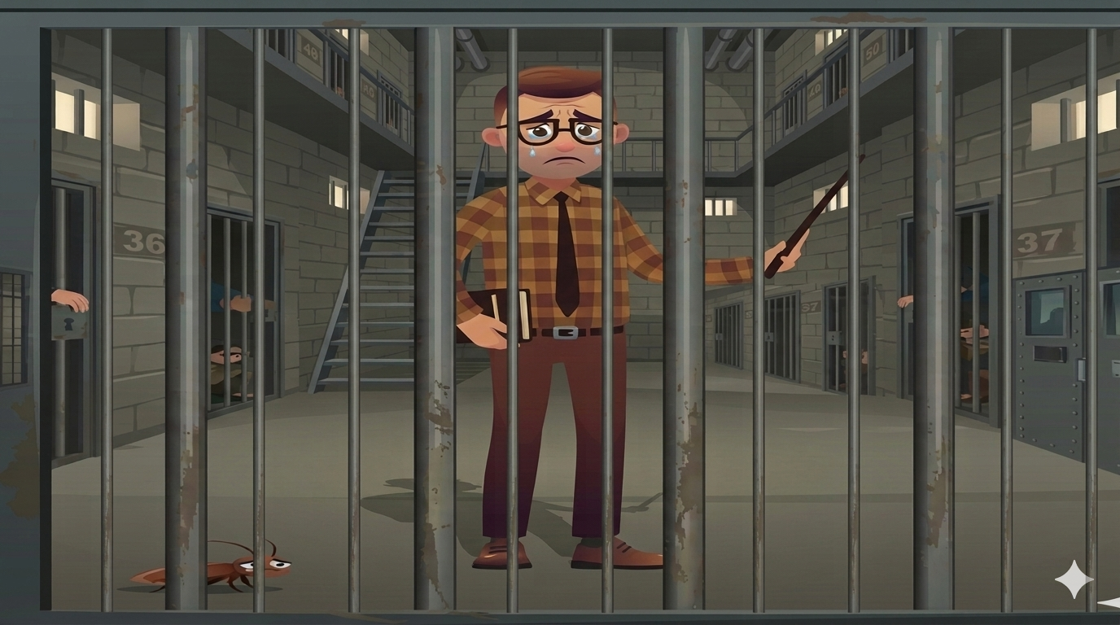

YOU WON!!!
YAYYYYY!!!
Play again?

